Slide 1
Voice-Based Email for Visually Challenged Users
GOKARAJU LAILAVATHI ENGINEERING COLLEGE
COMPUTER SCIENCE AND ENGINEERING
TEAM NAME : WEBVERSE
  PROJECT MEMBERS
  T.AGASTHYA
  G.SNEHA
  CH.RAKSHITHA

Slide 2

Introduction & Problem Statement
A complete accessibility-focused email system using speech-to-text, text-to-speech, IVR navigation, and blind-click mouse interactions.
The internet and email systems require visual interaction.
Visually challenged users depend on third persons to
read/send emails.
Need for a fully voice-driven
and accessible email platform.

Slide 3
Proposed Solution
A web-based email system controlled entirely through voice commands.
Uses IVR prompts for navigation and
decision-making.
Eliminates keyboard usage;
relies on blind mouse-click patterns.
Integrates speech-to-text for composing and
text-to-speech for reading mails.
Provides independent email usage for visually challenged users.

Slide 4
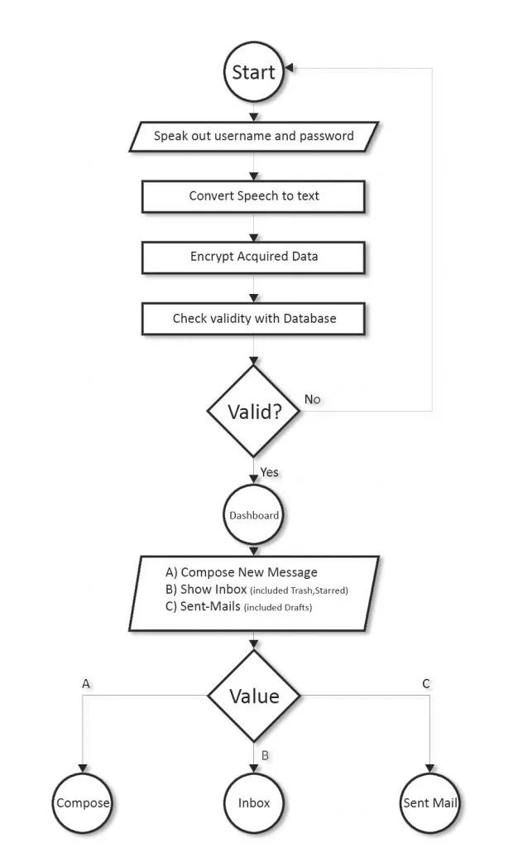
System Workflow Overview
User logs in using voice-based credential input.
Dashboard navigation is based on blind mouse clicks:
- Left Click → Compose Mail
- Right Click → Sent Mail
- Double Left Click → Inbox
- Scroll Click → Trash
- Double Right Click → Logout
All operations guided through IVR prompts.
Emails can be composed, read, filtered,
or deleted via voice.

Slide 5
System Design & Modules
Login Module: Secure voice-based username & password input.
Compose Mail Module: Voice input for recipient, subject, body; confirmation before sending.
Inbox Module: Voice-based filtering, mail reading with pause/resume.
Sent Mail & Trash: Sort, filter, read, and delete using voice.
Drafts: Save incomplete emails through click-based navigation.

Slide 6
Technologies Used
Frontend: HTML, CSS, JS
Backend: PHP (processing, authentication, email operations)
Database: MySQL (users, inbox, drafts, trash, sent mails)
APIs Used: Google Speech-to-Text, Text-to-Speech
Server: Apache HTTP Server
Support Systems: IVR-based interaction logic

Slide 7
Key Features & Advantages
100% voice-driven email system.
No keyboard or visual dependency.
Simple blind-click navigation.
Increased digital inclusion for visually impaired users.
Minimal training required.
Encourages accessible technology development.

Slide 8
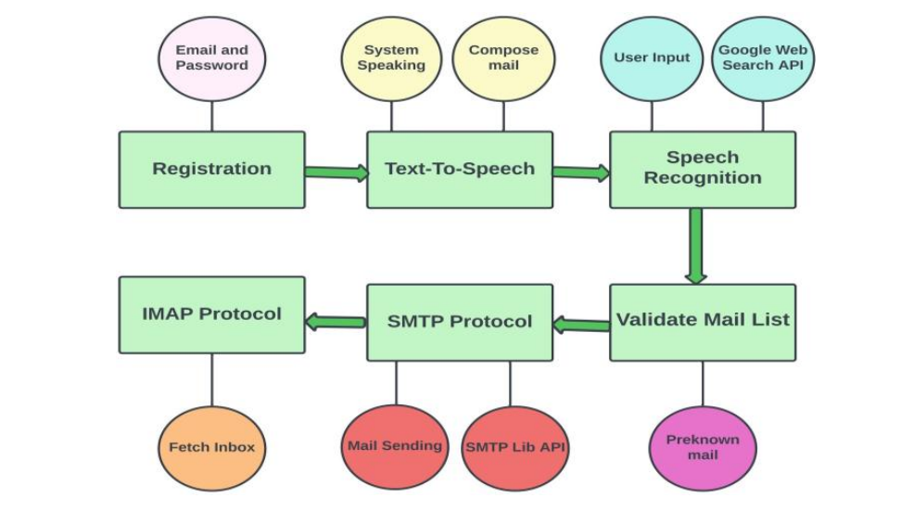
IMPLEMENTATION

Slide 9
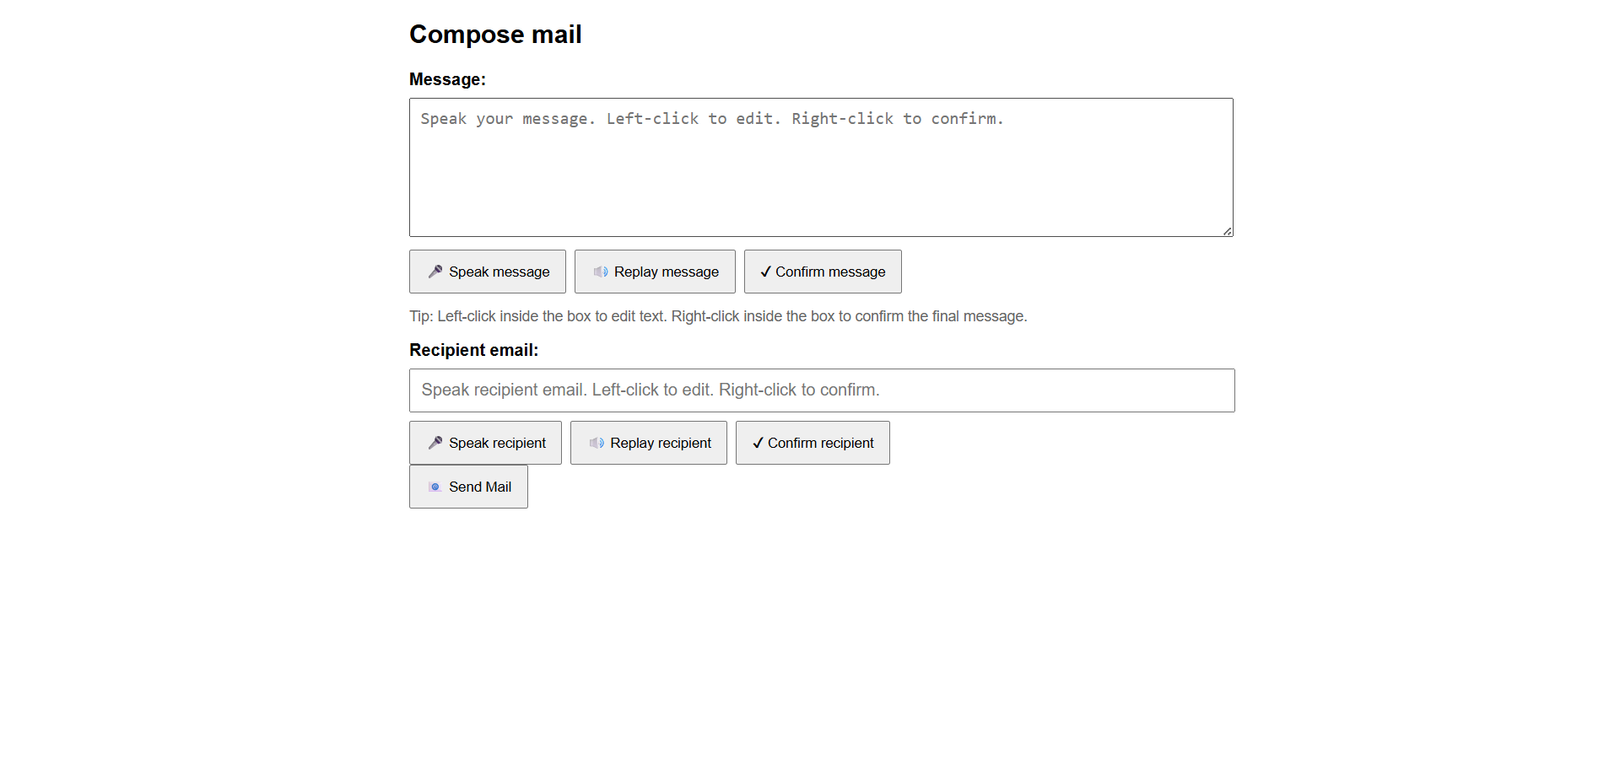
EXPECTED OUTPUT

Slide 10
Conclusion
The voice-based email system empowers visually challenged individuals by enabling independent, secure, and accessible email communication. With speech technologies, IVR guidance, and simplified navigation, the project contributes significantly to digital accessibility and inclusivity.

Slide 11


Slide 12
